Slide 1
Durable Functions
Reliable Long-Running Function Orchestrations at Scale

Slide 2
Why do we need “Durable Functions”
Enable “long running” functions while maintaining local state
Simplify complex Function coordination (chaining, etc.)
Easily call a Function from another Function
All of the above using code-only

Slide 3
What is Durable Functions?
Advanced feature for writing long-running orchestrations as a single C# / JavaScript function. No JSON schemas. No designer.
New orchestrator functions can synchronously or asynchronously call other functions.
Automatic checkpointing, enabling “long running” functions.

Slide 4
What is Durable Functions?
Solves a variety of complex, transactional coding problems in serverless apps
Built on the open source Durable Task Framework

Slide 5




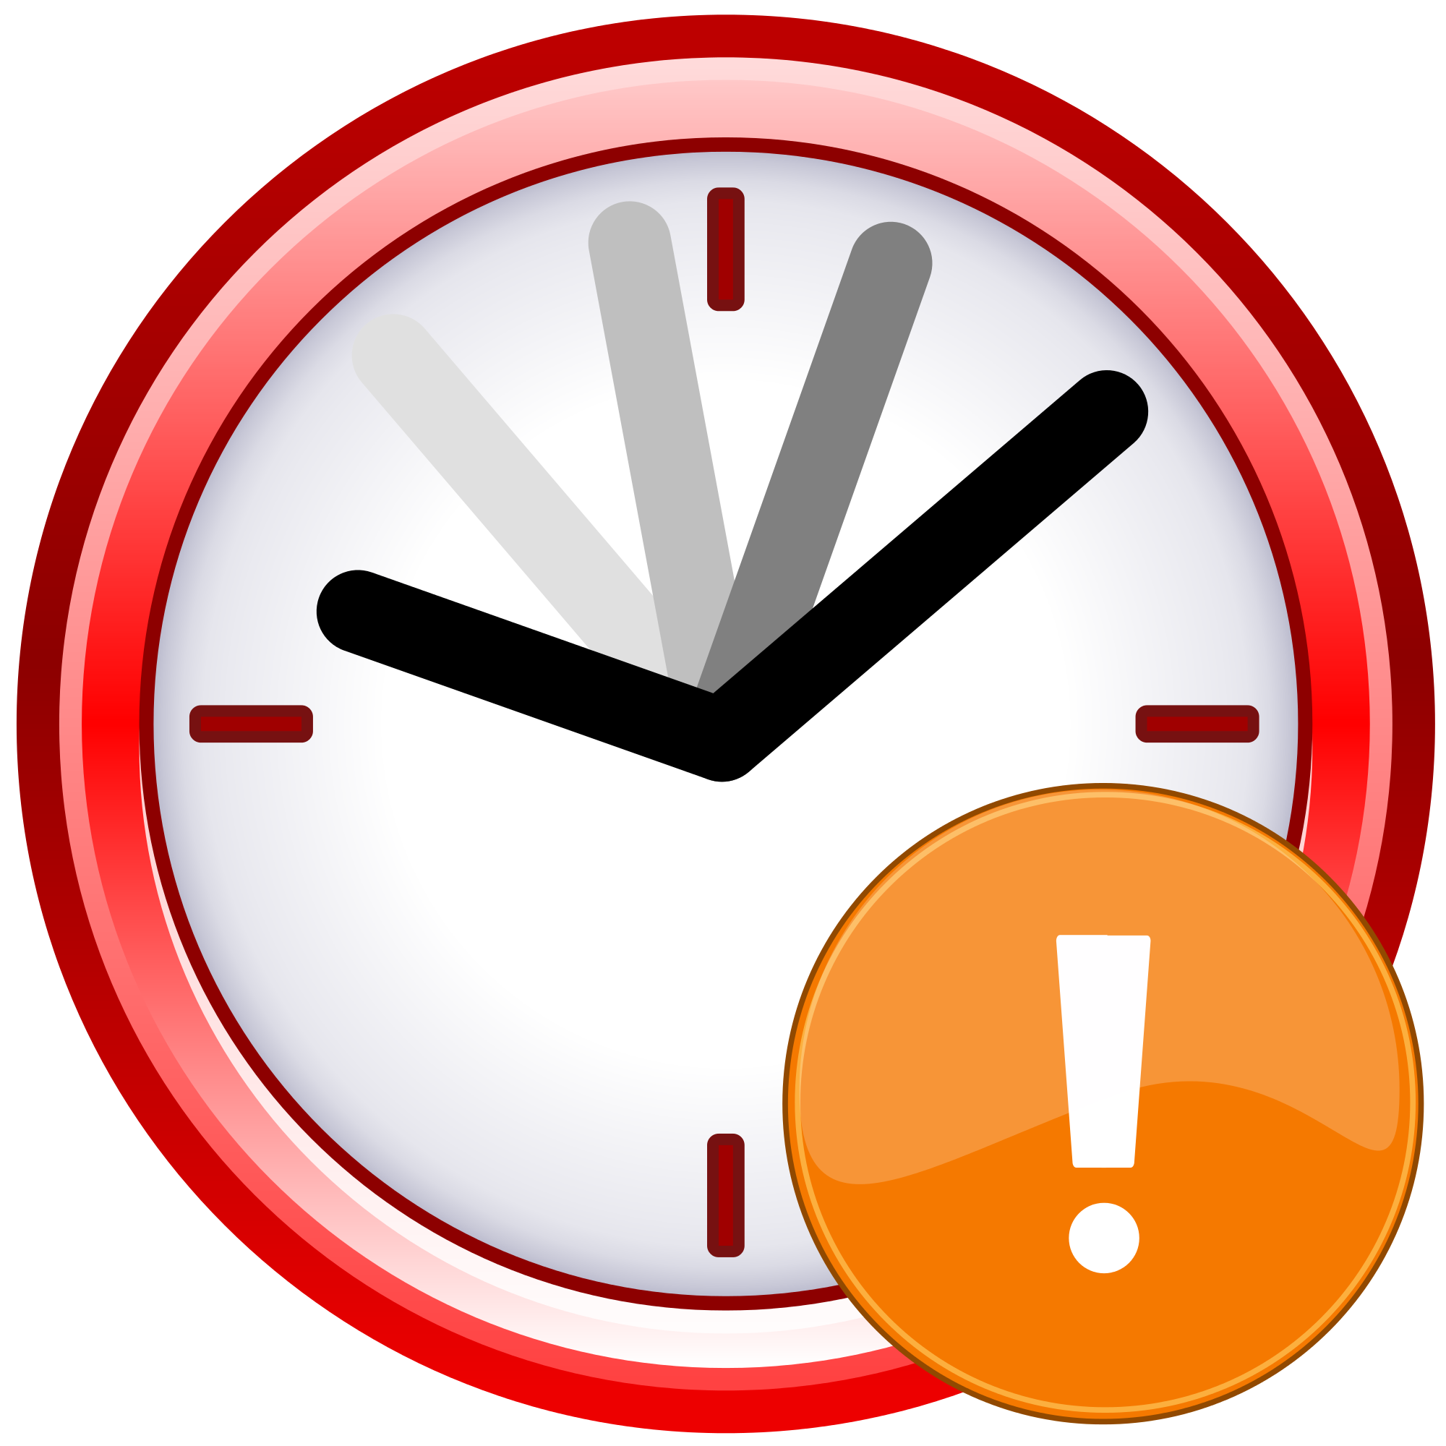
Function Orchestration Patterns
Function chaining
Fan-out / fan-in
Event aggregation
Extended Status Monitoring
Human interaction / timeout
Async HTTP APIs
http

Slide 6

Pattern #1: Function chaining - Today
F1
F2
F3
F4
Problems:
No visualization to show relationship between functions and queues
Middle queues are an implementation detail – conceptual overhead
Error handling adds a lot more complexity

Slide 7

Pattern #1: Function chaining – Durable Functions
Orchestrator Function
F1 Function
F2 Function
F3 Function
F4 Function

Slide 8
Pattern #1: Function chaining - Better
// calls functions in sequence
public static async Task<object> Run(DurableOrchestrationContext ctx)
{
try
{
var x = await ctx.CallFunctionAsync("F1");
var y = await ctx.CallFunctionAsync("F2", x);
var z = await ctx.CallFunctionAsync("F3", y);
return await ctx.CallFunctionAsync("F4", z);
}
catch (Exception)
{
// global error handling/compensation goes here
}
}
Notes:
CallFunctionAsync uses queues under the covers, thus they can be scaled out to multiple VMs.

Slide 9
Pattern #2: Fan-out/Fan-in - Today
F1
F3
F2
Problems:
Fanning-out is easy, but fanning-in is significantly more complicated
Functions offers no help with this scenario today
All the same problems of the previous pattern

Slide 10
Pattern #2: Fan-out/Fan-in – Durable Functions
Orchestrator Function
F1 Function
F2 Function
F2 Function
F2 Function
F3 Function

Slide 11
Pattern #2: Fan-out/Fan-in - Easy
public static async Task Run(DurableOrchestrationContext ctx)
{
var parallelTasks = new List<Task<int>>();
// get a list of N work items to process in parallel
object[] workBatch = await ctx.CallFunctionAsync<object[]>("F1");
for (int i = 0; i < workBatch.Length; i++)
{
Task<int> task = ctx.CallFunctionAsync<int>("F2", workBatch[i]);
parallelTasks.Add(task);
}
await Task.WhenAll(parallelTasks);
// aggregate all N outputs and send result to F3
int sum = parallelTasks.Sum(t => t.Result);
await ctx.CallFunctionAsync("F3", sum);
}

Slide 12
Pattern #3: HTTP Async Response
Start
DoWork
GetStatus
Problems:
Execution state needs to be explicitly stored and managed
Execution state and trigger state must be kept in sync manually
Start and GetStatus is often boilerplate code that is not related to the business problem

Slide 13
Pattern #3: HTTP Async Response – Built in!
> curl -X POST https://myfunc.azurewebsites.net/orchestrators/DoWork -H "Content-Length: 0" -i
Location: https://myfunc.azurewebsites.net/orchestrators/b79baf67f717453ca9e86c5da21e03ec
> curl https://myfunc.azurewebsites.net/orchestrators/b79baf67f717453ca9e86c5da21e03ec -i
HTTP/1.1 202 Accepted
{"runtimeStatus":"Running","createdTime":"2017-03-16T21:20:36Z","lastUpdatedTime":"2017-03-16T21:20:47Z"}
> curl https://myfunc.azurewebsites.net/orchestrators/b79baf67f717453ca9e86c5da21e03ec -i
HTTP/1.1 200 OK
{"runtimeStatus":"Completed","createdTime":"2017-03-16T21:20:36Z","lastUpdatedTime":"2017-03-16T21:20:57Z"}
Notes:
Logic Apps and Microsoft Flow have built-in support for this pattern.
Note that specifics URL routes are subject to change (and have already changed since this deck was originally written).

Slide 14
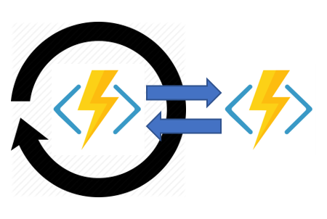
Pattern #4: Monitoring
Problems:
Functions are stateless and short-lived
Enabling flexible recurring intervals in a workflow is difficult
Creation of multiple monitor processes is not straightforward

Slide 15
Pattern #4: Monitoring
public static async Task Run(DurableOrchestrationContext ctx)
{
int jobId = ctx.GetInput<int>();
int pollingInterval = GetPollingInterval();
DateTime expiryTime = GetExpiryTime();
while (ctx.CurrentUtcDateTime < expiryTime)
{
var jobStatus = await ctx.CallActivityAsync<string>("GetJobStatus", jobId);
if (jobStatus == "Completed")
{
// Perform action when condition met
await ctx.CallActivityAsync("SendAlert", machineId);
break;
}
// Orchestration will sleep until this time
var nextCheck = ctx.CurrentUtcDateTime.AddSeconds(pollingInterval);
await ctx.CreateTimer(nextCheck, CancellationToken.None);
}
// Perform further work here, or let the orchestration end
}
Notes:
Note that orchestrators are single-threaded, so there is no need to worry about concurrency. Orchestration instances are also implicitly singletons, so they only run on one VM at a time.

Slide 16
Pattern #5: Human Interaction w/Timeout
ProcessApproval
RequestApproval
Escalate
Problems:
Can’t easily coordinate a timeout with an approval request notification
Need a mechanism to reliably cancel either the approval handling or the timeout depending on the outcome

Slide 17
Pattern #5: Human Interaction w/Timeout
public static async Task Run(DurableOrchestrationContext ctx)
{
await ctx.CallFunctionAsync<object[]>("RequestApproval");
using (var timeoutCts = new CancellationTokenSource())
{
DateTime dueTime = ctx.CurrentUtcDateTime.AddHours(72);
Task durableTimeout = ctx.CreateTimer(dueTime, 0, cts.Token);
Task<bool> approvalEvent = ctx.WaitForExternalEvent<bool>("ApprovalEvent");
if (approvalEvent == await Task.WhenAny(approvalEvent, durableTimeout))
{
timeoutCts.Cancel();
await ctx.CallFunctionAsync("HandleApproval", approvalEvent.Result);
}
else
{
await ctx.CallFunctionAsync("Escalate");
}
}
}
Notes:
We will expose a mechanism for sending named events to an orchestrator from outside the orchestration context – e.g. REST API and/or output binding.

Slide 18
Durable Functions Design
Reliable Long-Running Function Orchestrations at Scale

Slide 19
Function Types
Activity Function #1
(Worker)
Orchestration Client (Trigger)
Orchestrator
(Coordinator)
Activity Function #2
(Worker)
Activity Function #3
(Worker)

Slide 20
Language Support
Activity functions and orchestrator client functions can be any supported language
Orchestrator functions support C# (GA) & JavaScript (Preview)
What language do you want?

Slide 21
Orchestration Client
Activity Function #1
(Worker)
Orchestration Client (Trigger)
Orchestrator
(Coordinator)
Activity Function #2
(Worker)
Activity Function #3
(Worker)

Slide 22
Bindings - Orchestrator Client
Output binding
Start new orchestrator instances / Fetch Status
Terminate instances
Send event notifications
Notes:
*Fetching instance status feels odd for an output binding. We may need a separate input binding for this.

Slide 23
Orchestrator
Activity Function #1
(Worker)
Orchestration Client (Trigger)
Orchestrator
(Coordinator)
Activity Function #2
(Worker)
Activity Function #3
(Worker)

Slide 24
Bindings - Orchestration Trigger
Triggers orchestrator functions
Polls control-queue
Partition-aware
Handles return values
Notes:
*Fetching instance status feels odd for an output binding. We may need a separate input binding for this.

Slide 25
Activity Function
Activity Function #1
(Worker)
Orchestration Client (Trigger)
Orchestrator
(Coordinator)
Activity Function #2
(Worker)
Activity Function #3
(Worker)

Slide 26
Bindings - Activity Trigger
Triggers activity functions
Polls work-item queue
Stateless
Handles return values
Notes:
*Fetching instance status feels odd for an output binding. We may need a separate input binding for this.

Slide 27

Storage Backend & Scale
Worker
Orchestrator
Control Queue(s)
Orchestrator
Work Item Queue
Triggers orchestrator
function execution
Triggers activity function execution
Orchestrator
Worker
Stateful/Partitioned
History & Instances Tables
Stateless
Notes:
Detailed design is pending.

Slide 28
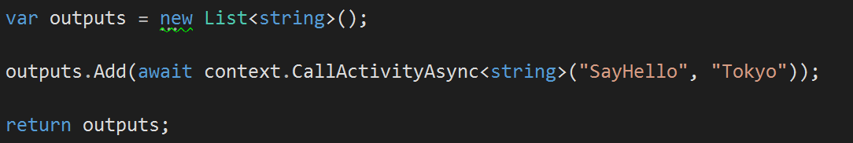
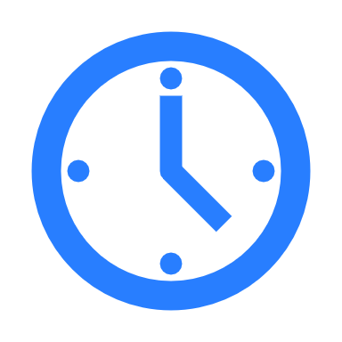

Orchestrator Function
Activity Function
Orchestrator Function
Activity Function
Orchestrator Started
Execution Started
Task Scheduled, SayHello, “Tokyo”
“Hello Tokyo!”
Orchestrator Completed
[“Hello Tokyo!”]
“Hello Tokyo!”
Task Completed, “Hello Tokyo!”
?
Orchestrator Started
Execution Completed, ["Hello Tokyo!"]
Orchestrator Completed
Execution History
Notes:
Purpose: Walk through a simple hello world scenario to illustrate how the runtime executes orchestrator functions.
Emphasize: the use of event sourcing pattern to rebuild local state

Slide 29
Orchestrator Behavior
Orchestrator code is replayed on every rehydration to restore all local state (local variables, etc)
Function calls are never replayed – the outputs are remembered

Slide 30
Starter
(Orchestration Client)
Control Queue
Orchestrator
SayHello (Worker)
Work-Item Queue

Slide 31
Orchestrator code must be deterministic
Rule #1
Never write logic that depends on random numbers, DateTime.Now, Guid.NewGuid(), etc.
Rule #2
Never do I/O directly in the orchestrator function
Rule #3
Do not write infinite loops
Rule #4
Use the built-in workarounds for rules #1, #2, and #3

Slide 32
Orchestrator functions key takeaways
Code: code-oriented way to implement business logic
Stateful: local variables and execution progress is preserved
Durable: no state is lost when the process recycles or the VM reboots

Slide 33
Orchestrator functions key takeaways
Long-running: they can theoretically run forever
Can go to sleep (dehydrate) and billing can be stopped while waiting for results
Automatically wake up (hydrate) when there is more work to do

Slide 34
Orchestrator functions key takeaways
Scalable: queue-based messaging allows for massive scale-out.

Slide 35
Durable Functions - Demo
Reliable Long-Running Function Orchestrations at Scale
Notes:
Use one of the samples available here - https://github.com/Azure/azure-functions-durable-extension/tree/master/samples/precompiled

